Slide 1

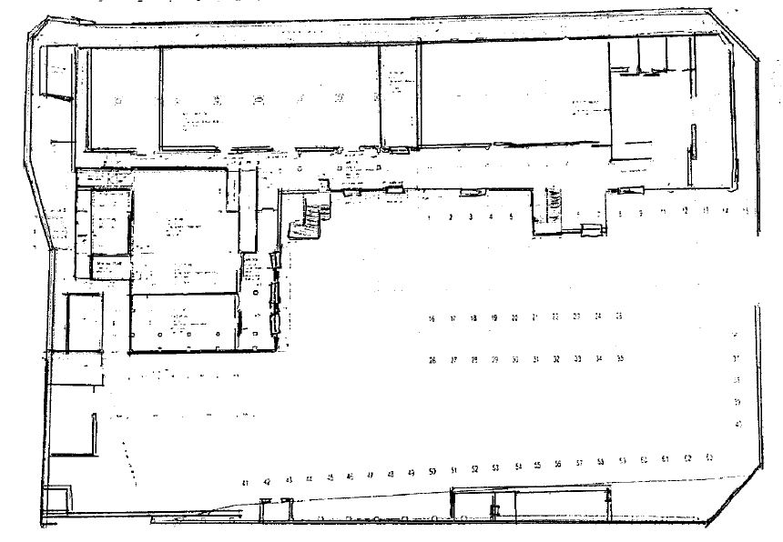
19
20
21
22
23
24
25
26
Millenium Meats
Cnr Helderburg & Gordon Roads. Bergbron
24 July 2014
Name: _____________
Signature:__________
18
35
17
1
2
34
5
4
3
2
1
27
31
32
16
30
15
6
28
29
33
14
7
13
8
Flick Environmental Services (PTY) Ltd
24 July 2014
Name: _____________
Signature:__________
11
12
10
9
Legend
1-36
External Tamper Proof
Rodent Stations
Internal snap traps
Entry and Exit Points

